Slide 1
The Economy:
How Did we Get Here and
Where are we Going?
Thomas H. Greco, Jr.
Michigan's Future: Energy, Economy & Environment
November 2009
Notes:
Wissner:
What happened? Specifically, what happened with the economy over the
past couple of years. What does house prices have to do with it? What
does fractional reserve lending and reserve requirements have to do with
it? What did regulation or lack of have to do with it? What did the
issuance of money have to do with it? What is money anyway? How does
the energy supply (oil supply) relate to the value of money? Knowing
all of this, what are some scenarios for how things will play out?

Slide 2
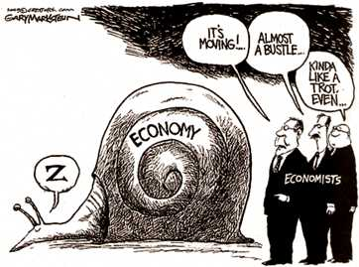

Slide 3
Critical Questions
What has happened to the global economy and financial infrastructure over the past three years?
What are the underlying causes of the current financial crisis?
What are the near-term and long-term prospects? When will the economy get back to normal?
What are the emerging challenges, patterns, and opportunities?

Slide 4
Mega-Crisis
Is This the End of the Growth Economy?
Climate Change
  Greenhouse gasses > Global warming/cooling?
End of Cheap oil
  Increasing costs of production and transportation
Resource Depletion
  Fresh Water, Soil fertility, Minerals, Forests, Marine resources, etc.
Pollution
Financial Disruption
  Bankruptcies & Unemployment
  Currency debasement and chronic deficits
  Inflation
General Institutional Failure

Slide 5
Seven Areas in Urgent Need of Restructuring
Banking & Finance
Taxation and public revenue
Land (property) ownership, tenure, and use
Money
Corporate personhood and power
Government and law
Technology and public policy

Slide 6
The Political Money Regime
Centralizes power and concentrates wealth
Undermines popular government
Forces artificial growth
  The debt imperative > growth imperative
Erodes the social fabric
Destroys the environment
Money is kept artificially scarce, is mis-allocated, and expensive
Notes:
"As is common in most modern discussions, the unmentionable thing is the pivot of the whole discussion." – GK Chesterton
Throughout the world, money and banking have been politicized making money an instrument of political power that adversely impacts the society, the economy, and the environment.
Money and banking are manipulated by and for limited private interests.
Political money is exploitative, dysfunctional, and undemocratic.
Money today exists mainly as bank credit that must be borrowed into circulation at interest.
The global monetary system has institutionalized interest (usury), which creates a growth imperative.

Slide 7
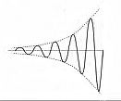
Systemic Failure of Conventional Money and Banking
The political money system is shaking itself apart
Bubble-and-bust cycles are becoming ever more extreme
Explosive expansion of debt and debasement of the money
The Humpty-Dumpty syndrome
Bubble
Bust
Notes:
Small perturbations are being amplified at each cycle. Enormous amounts of effort and resources are being applied in a vain attempt to put the system back together. What is it costing us?

Slide 8
Unreliable Bank Credit
Modern money is simply credit
The availability of credit to the productive sector, especially to SMEs, is becoming ever more uncertain and unreliable
The political money system favors the demands of
  BIG banks,
  BIG corporations and
  BIG government.

Slide 9
Essential Elements of the Political Money System
Credit Monopoly by the banking cartel headed by
The central bank, whose currency is granted the privileged status of
Legal tender, which is lent into circulation at interest, which requires the
Endless expansion of debt
By lending to either the private sector or the public sector,
Causing a Growth Imperative

Slide 10
Money – Instrument of Power
Money has been the Primary Lever for Centralizing Power and Concentrating Wealth.
Whoever controls the volume of money in any country is absolute master of all industry and commerce.
- President James A. Garfield
Those who create and issue money and credit direct the policies of government and hold in the hollow of their hands the destiny of the people. - Sir Reginald McKenna, former President of the Midland Bank of England
Notes:
Give me the power to create a nation’s money, and I care not who makes the laws. -- Mayer Amschel Rothschild
“The study of money, above all other fields in economics, is one in which complexity is used to disguise truth or to evade truth, not to reveal it.” - John Kenneth Galbraith, economist, in his book, Money: Whence It Came, Where It Went, 1975

Slide 11
Growth of One Dollar at Compound Interest
 | 6% | 10%
50 years | $18.42 | $117.39
100 years | $339.30 | $13,780.65
200 years | $115,124. | $189,906,200.

Slide 12
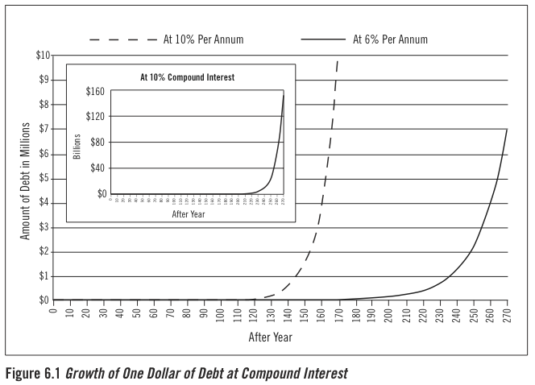

Slide 13
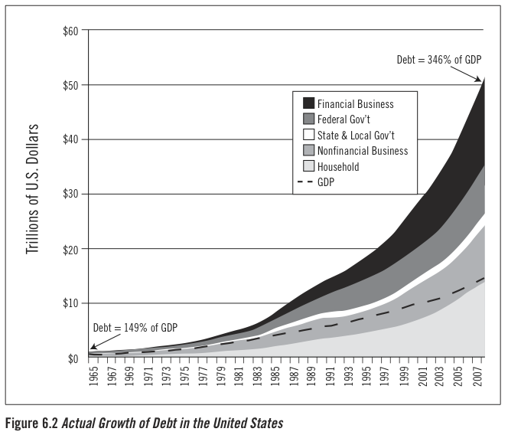
Notes:
George Soros also claims that Obama is facing problems 2X those faced by FDR. The total outstanding credit was 160% GDP in 1929, 260% in 1932 (decline in GDP, accumulation of debt). By comparison, we entered the 2008 crash at 365%, and Soros believes this will rise to about 500% of GDP. – Amazon.com, about The New Paradigm for Financial Markets: The Crash of 2008 and What it Means.
"This crisis ...has brought the entire [financial] system to the brink of a breakdown, and it is being contained only with the greatest difficulty. This will have far reaching consequences. It is not business as usual but the end of an era." p. 81. The New Paradigm for Financial Markets: The Credit Crisis of 2008 and What It Means

Slide 14
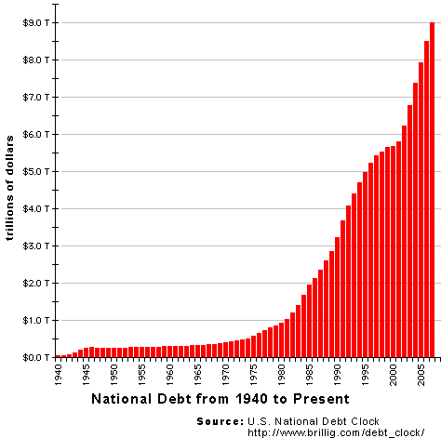
$11.67 trillion
as of October 2009
$47 trillion, including guarantees
United States National Government Debt
Notes:
US Debt Clock http://www.usdebtclock.org/. From 9 to 11.67; that’s an increase of almost 30 % in just the past 2 years.

Slide 15
The Credit Commons
Public sector “loans”
Private sector “loans”
Banks
“loans”
Central Government
Modern money is CREDIT
The Credit Commons can be accessed only by
“borrowing” from banks!
Notes:
Privatization of the commons. Banks throttle the credit allocation process and exploit users of credit by charging interest for its use.
Central governments spend as much as they wish without regard to the amount of their tax or other revues. This is called “deficit spending” and its result is debasement of its currency unit, a phenomenon commonly referred to as inflation.

Slide 16
The Credit Commons Has Been Privatized
Access to credit is controlled by the banking cartel
  Banks decide who gets access and on what terms.
  Banks charge interest on all “loans.”
National governments have extraordinary access.
  By their collusion with the banking interests, they can “borrow” as much as they wish and never repay.
The resultant Interest and Inflation are parasitic drains on the economy.

Slide 17
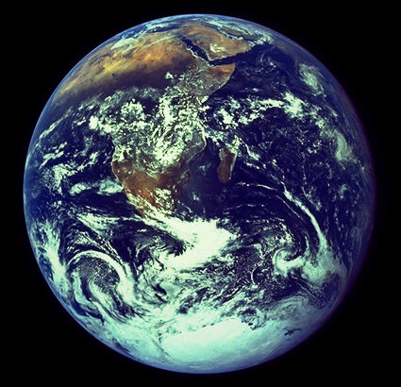
Societal Metamorphosis
Transcending the Growth Imperative
“We stand at a critical moment in Earth’s history, a time when humanity must choose its future. ….To move forward we must recognize that in the midst of a magnificent diversity of cultures and life forms we are one human family and one Earth Community with a common destiny.”
– The Earth Charter

Slide 18
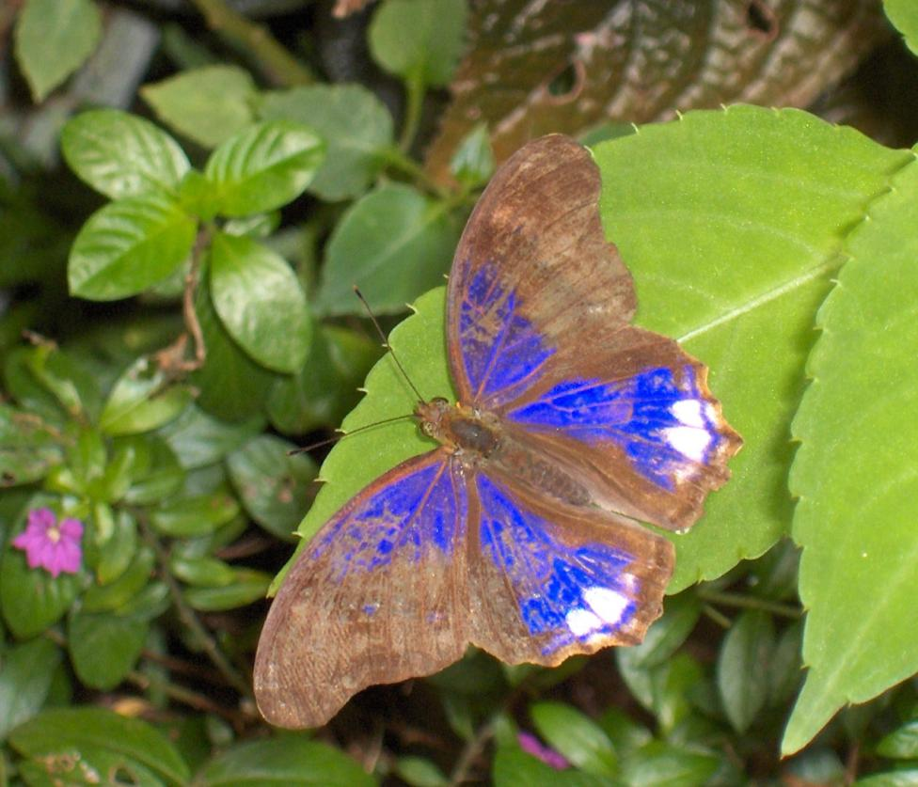
From
Superfluous accumulation,
violent conflict, and
wasteful consumption
To
Sustainable conviviality

Slide 19
Relocalization Means a
Shift of power!
Reclaim the Credit Commons
by Reorganizing the Exchange Function
  Organize and use community exchange systems and complementary currencies.
Rethink Your Personal Finances and Invest in the Butterfly, Not the Caterpillar
  Spending
  Saving
  Investing
  Should be consistent with your values and in support of your local communities.
Notes:
Your most important ballot is the one you cast when you use your money. Your spending and investment choices should be based on your personal values and objectives.
Support producers and products that do the right things in the right ways.

Slide 20
Transitions
Devolution of power and control
Sustainable Development vs. Growth
Steady-state economy
Livelihood vs. Jobs
More equitable distribution vs. increasing disparities of income and wealth
Quality of Life vs. Quantity of Consumption
Notes:
The world has reached the limits to growth. The production problem has been solved.

Slide 21
A New Paradigm for Community Development
Preparing for a sustainable future and a steady-state economy

Slide 22
Common Problems of
Regional Economies
Local producers are forced to compete with outside producers that are:
  Subsidized,
  Enjoy political privilege,
  Have easier access to capital, or
  Do not play by the same rules
Conventional money is scarce, and money that comes in, goes quickly out again.
Local businesses are starved for credit & capital.
Terms of trade are dictated by outside corporate buyers or sellers who dominate markets.
Resources and wealth are siphoned off by absentee owners.
Notes:
This is essentially a process of colonization. It is most notable in international trade, but also applies to internal relationships between communities and global corporate players.

Slide 23
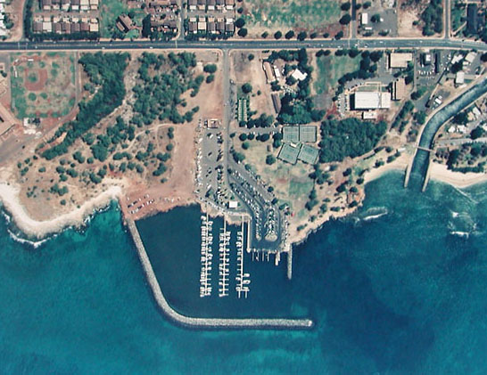
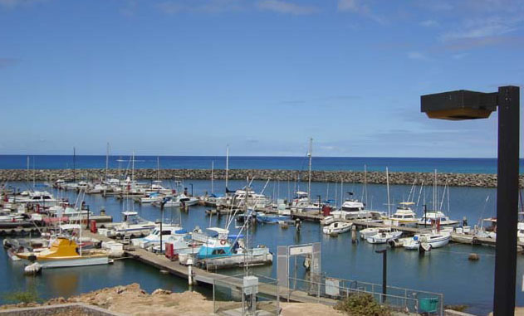
Relocalization = Building Safe Harbors
— A rising tide may lift all boats, but the tidal wave of globalization smashes all but the biggest.
Notes:
Waianea, Hawaii small boat harbor.

Slide 24
How to Insulate, but not Isolate, the local economy to:
Reduce exploitation,
Enhance economic vitality,
Enable self-determination, and
Optimize the community's standard of living and quality of life?

Slide 25
Prescriptions
  Withdraw from the race to the bottom
  Reduce competition with other economies
  Invest in local infrastructure and enterprises already here
Reduce dependence upon imports and export markets
  Import substitution
  Produce more for local consumption
Increase local value-added
Enhance opportunities for local exchange
Monetize local value-added

Slide 26
Emergent Alternatives
Trade Exchanges and
Private alternative currencies
are well positioned to provide SMEs and local economies with
Reliable credit and
Supplemental exchange media,
Based on the exchange of real value
By monetizing local value added—A superior service in a changing environment.

Slide 27
Who is Qualified to Issue Currency Credits?
Businesses and Professional Service Providers - based on goods and services that are in everyday demand.
Municipal governments – based on anticipated revenues from taxes and fees.
Associations of any or all of the above – based on their collective capacity to provide value to the community.
The amount issued must not be excessive in relation to the revenue stream.

Slide 28
Requirements for a Sound Exchange System
Proper basis of issue of credit
Adequate rate of credit reflux to the issuer
Competent, honest, and transparent management
Revenues adequate to cover operating costs
Effective oversight and participation by the members/users

Slide 29
Mutual Credit Issuance and Circulation
Member - Issuers
Member - Non-Issuers
Mutual credit clearing association
Participants utilize their own credit directly within a network of trust.
They allow one another to draw upon the common credit pool.
Notes:
Issuing members begin the process by buying from other members.

Slide 30
The WIR Model
The WIR Business Circle Cooperative has demonstrated
the power of direct credit clearing both in times of financial crisis and in normal times, and
its competitive superiority to conventional money and banking in facilitating the exchange of goods and services among businesses.

Slide 31
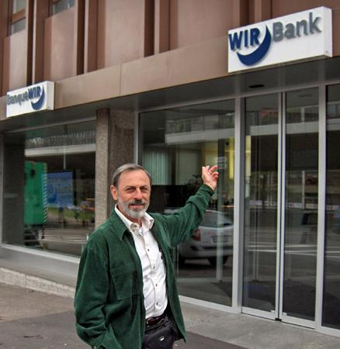

A Successful Mutual Credit Clearing Association
The WIR business circle cooperative (Wirtschaftsring) was founded by the “entrepreneurial middle-class.” in Switzerland in 1934 as an answer to the money scarcity of the Great Depression, and still thrives after 75 years.
60,000 business members
$2 billion in transactions cleared annually.
Notes:
The standards applied in granting credits were often far too lenient.

Slide 32




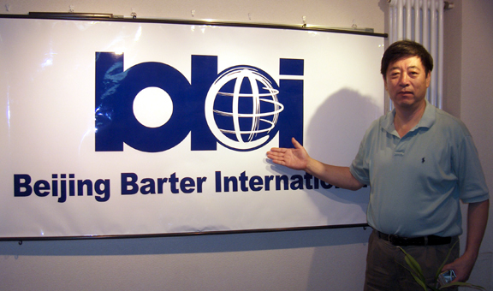







Commercial Trade Exchanges Proliferate

Slide 33
Modern Trade and Barter
In 2008, about 250,000 North American companies conducted barter transactions worth more than $16 billion.
About $11 billion of that involved small and medium sized businesses.
Seattle-based BizXChange Inc. saw a 40% increase in new members to 1,300 last year. Its transactions were up 55% to $5.5 million.
-- Wall Street Journal Feb. 17, 2009

Slide 34
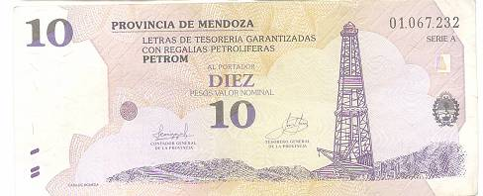
Provincial Currencies
Since the mid-1980’s, due to the lack of sufficient federal currency, many of Argentina’s 24 provinces issued their own currencies to meet their liquidity and budgetary needs.
By 2003, 20 provinces had issued provincial currencies of various types.
The province of Mendoza issued treasury notes backed by their oil royalties.
The province of Buenos Aires issued notes totaling one billion pesos.
Notes:
Mendoza - a total of $150,000,000 in notes called PETROM. They expire on March 30, 2007 and will be redeemed for 135% of its face value.

Slide 35
A 5 Stage Regional Development Program
Promote import substitution
Provide local businesses with an alternative means of payment
Issue a regional currency
Develop social capital and basic support structures
Develop and adopt an independent value standard and unit of account
Ref.: The End of Money and the Future of Civilization, Ch. 16.

Slide 36
Mutual Credit Clearing Associations and
Community Currencies
  Provide Exchange Media That Are:
    Abundant
    Community controlled
    Democratically allocated
    Interest-free
    Self-adjusting, Stable and Sustainable
    Resulting in greater local self-determination, social harmony, equity, justice, and better quality of life for all.

Slide 37
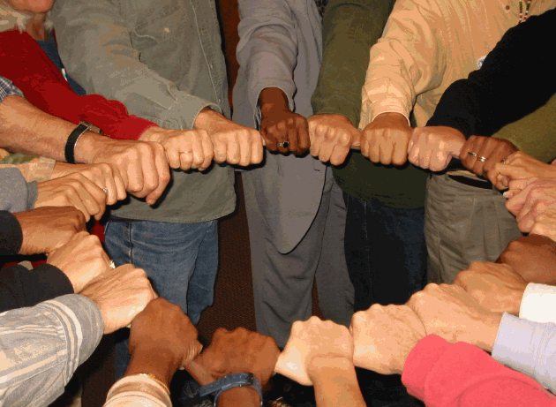
Everybody Wins!

Slide 38
References and Resources
Explore the website and blog:
http://www.ReinventingMoney.com
http://beyondmoney.net
Read:
The End of Money and the Future of Civilization
Money: Understanding and Creating Alternatives to Legal Tender
Money and Debt: A Solution to the Global Crisis
by Thomas H. Greco, Jr.
Flight From Inflation by E. C. Riegel

Slide 39
Credit Functions
Two Distinct Kinds of Credit
Exchange Credit | Finance Credit
Purpose: to facilitate exchange Short-term Newly created money | Purpose: to fund capital development Long-term Reallocation of existing money from savers to entrepreneurs

Slide 40
The Future Exchange Network
  Local trade exchanges will merge into wide area trading networks that:
  Offer universally accepted, non-cash payment (credit clearing)
  Bring in new participants in diverse locations and industries
  Open up new levels of the supply chain
  Stimulate new innovative means of commerce
  Reach a tipping point and grow exponentially
Notes:
A main point in my 2006 keynote was this outline of a great opportunity.

Slide 41
Seven Areas in Urgent Need of Restructuring
Money
Banking & Finance

